Slide 1

Unit 5

Slide 2


To learn to write a movie review.

Slide 3


think of
1. 想起 ______________________
2. 例如 ______________________
3. 发行; 出版 ______________________
4. 在二十世纪三十年代 ______________________
5. 主要原因之一 ______________________
6. 努力做某事 ______________________
7. 准备好做某事 ______________________
8. 尽最大努力 ______________________
such as
come out
in the 1930s
one of the main reasons
try to do sth.
be ready to do sth.
try one’s best

Slide 4
Fill in the blanks to explain why Mickey is popular.
Some people might ask _____________ this cartoon animal became so popular. ____________________ is that Mickey was like a common man, but he always _____________ face any danger. In his early films, Mickey was unlucky and had many problems _____________ losing his house or girlfriend. However, he _________________ to ____________________. He is a _____________ of American culture.
how
One of the main reasons
tried to
such as
was always ready
try his best
symbol

Slide 5



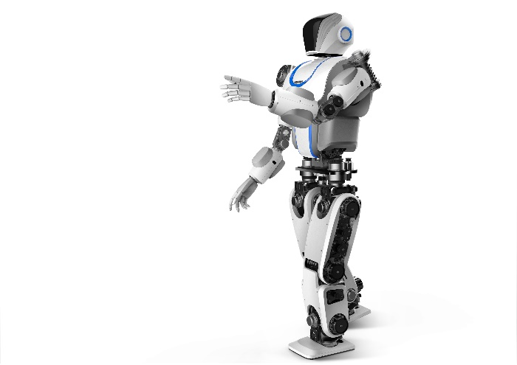
1. dress up 装扮; 乔装打扮
e.g. The girls dressed up to take part in the party.
女孩子们打扮好去参加舞会。
2. take one’s place 代替; 替换
e.g. A robot will take his place to do the job.
机器人将代替他的位置去做那项工作。

Slide 6
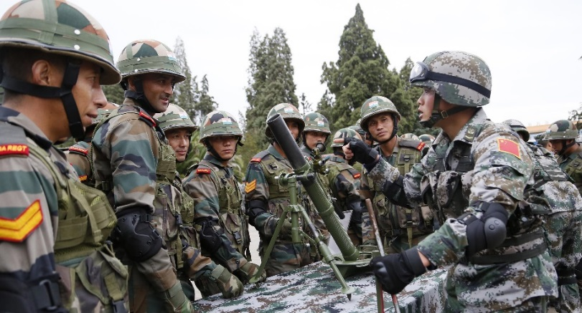
3. army n. 陆军; 陆军部队
e.g. My brother joined the army last year.
去年我哥哥参了军。
4. do a good job 干得好
e.g. I hope you’ll do a good job in the company.
希望你在这个公司好好干。

Slide 7



Look at the picture.
What is the name of the movie?
What kind of movie is it?
What is the movie about?
Do you want to watch it?

Slide 8
Mulan didn’t have any brothers. She took her father’s place to join the army.
Mulan dressed up like a boy. Nobody knew she was a girl in the army.

Slide 9
木兰辞
唧唧复唧唧，木兰当户织。不闻机杼声，唯闻女叹息。
问女何所思，问女何所忆。女亦无所思，女亦无所忆。昨夜见军帖，可汗大点兵，军书十二卷，卷卷有爷名。阿爷无大儿，木兰无长兄，愿为市鞍马，从此替爷征。
东市买骏马，西市买鞍鞯，南市买辔头，北市买长鞭。旦辞爷娘去，暮宿黄河边，不闻爷娘唤女声，但闻黄河流水鸣溅溅。旦辞黄河去，暮至黑山头，不闻爷娘唤女声，但闻燕山胡骑鸣啾啾。
万里赴戎机，关山度若飞。朔气传金柝，寒光照铁衣。将军百战死，壮士十年归。
归来见天子，天子坐明堂。策勋十二转，赏赐百千强。可汗问所欲，木兰不用尚书郎，愿驰千里足，送儿还故乡。
爷娘闻女来，出郭相扶将；阿姊闻妹来，当户理红妆；小弟闻姊来，磨刀霍霍向猪羊。开我东阁门，坐我西阁床，脱我战时袍，著我旧时裳。当窗理云鬓，对镜帖花黄。出门看火伴，火伴皆惊忙：同行十二年，不知木兰是女郎。
雄兔脚扑朔，雌兔眼迷离；双兔傍地走，安能辨我是雄雌？

Slide 10
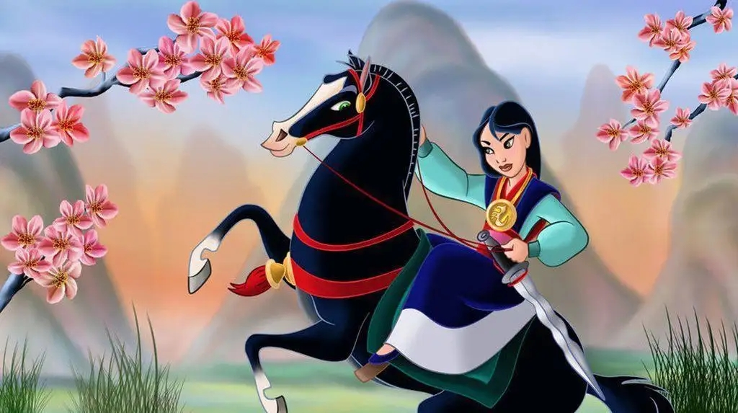
Unit 5
Do you want to watch a game show?

Slide 11
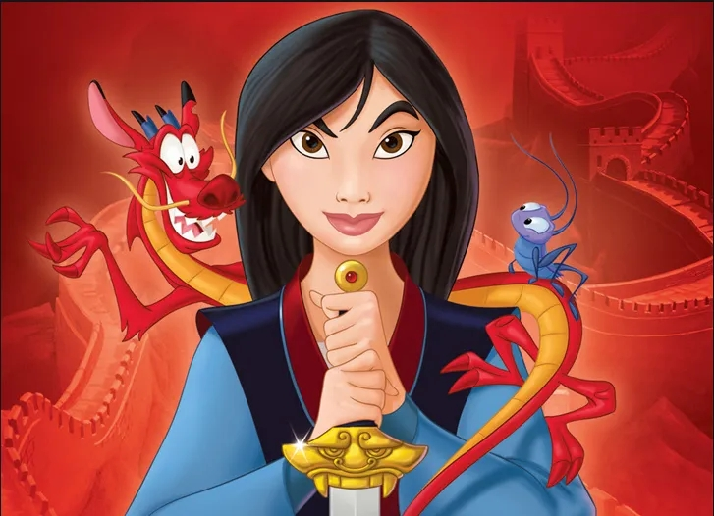


Slide 12
Topic: Write a movie/TV series(连续剧) review
写影评

Slide 13


Fill in the blanks in the movie review. Use the words in the box to help you.
fantastic shows action want comes from played about like exciting plan
Mulan is an ________ ______ movie. It ___________ an old Chinese story. The movie is ______ a village girl, Mulan. She dresses up like a boy and takes her father’s place to fight in the army. I think the actress _______ Mulan’s role well.
exciting action
comes from
about
played
take sb’s place 代替
dress up like/as 装扮成某人
fight in the army 从军打仗

Slide 14
fantastic shows action want comes from played about like exciting plan
do a good job 干得好
fantastic
The other actors are also _________ and they did a good job in the movie. I _____ Mulan very much. The movie _______ her love for her family, friends and country. If you ______ to watch a movie this weekend and you ______ to see something enjoyable, choose Mulan!
like
shows
plan
want

Slide 15
How to write a movie review!
Beginning：
Mulan is an exciting action movie.
电影名称+整体评价(adj.)+类型.
类型：comedy, action movie, cartoon, scary movie,
tragedy (悲剧), documentary (纪录片)...

Slide 16
How to write a movie review!
Body：
It comes from an old Chinese story. The movie is about a village girl, Mulan. She dresses up like a boy and takes her father’s place to fight in the army.
介绍电影内容
I think the actress played Mulan’s role well. The other actors are also fantastic and they did a good job in the movie.
评价演员

Slide 17
How to write a movie review!
Ending：
I like Mulan very much. The movie shows her love for her family, friends and country.
发表观点
If you plan to watch a movie this weekend and you want to see something enjoyable, choose Mulan!
推荐
Don’t miss it.
All in all, it’s worth (值得) watching.

Slide 18
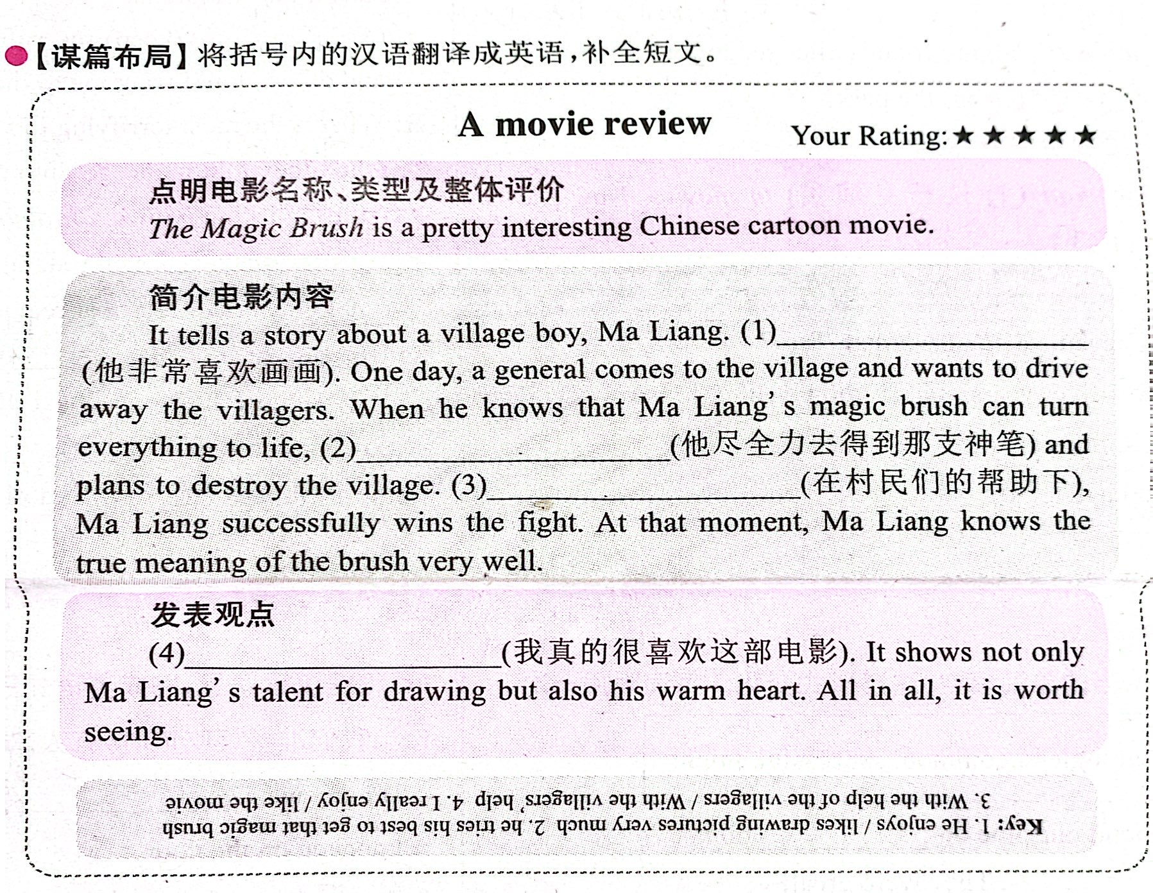

Slide 19


Write notes for a review about a movie/TV series .
The name: _______________
The kind: _______________
What is it about:
_____________________________________
_____________________________________
What you think of it:
_____________________________________
_____________________________________
Write your movie/TV series review using the notes in 3b.

Slide 20

What do you and your partner think of these TV shows or movies? Write description words for each one.
 | Me | My partner
soap operas
talent shows
news
sports shows
game shows
talk shows
comedies
scary movies
action movies
cartoons
good, great, educational, meaningless, serious, wonderful, enjoyable, relaxing, fun, exciting, boring, terrible

Slide 21


1. Write questions and answers using the words in brackets.
What do you think of soap operas?
I can’t stand them.
1. A: ______________________________
(what / think of / soap operas)
B: ___________________ (can’t stand)
What show do you want to watch tonight?
I want to watch a talent show.
2. A: ________________________________________
(what show/ want to watch / tonight)
B: ____________________________ (talent show)

Slide 22
3. A: __________________________________________
(what / expect to learn / game show)
B: __________________________________________
(interesting information)
What do you expect to learn from a game show?
I expect to learn some interesting information.
4. A: __________________________________________
(what / hope to watch / tomorrow)
B: __________________________________________ (news)
What do you hope to watch tomorrow?
I hope to watch the news.
Do you plan to watch an action movie?
No, I plan to watch a comedy.
5. A: __________________________________________
(do / plan to watch / action movie)
B: __________________________________________
(no / plan to watch / comedy)

Slide 23



2. Which of these statements do you agree with (√) or disagree with (×)? Give at least one reason.
1) I think game shows are meaningless. ( )
2) I can’t stand soap operas. ( )
3) I think sitcoms and talent shows are relaxing. ( )
4) I love talk shows. ( )
5) I think comedies are fantastic. ( )
I think we can learn some interesting information from game shows.
I think watching soap operas is a good way to relax.

Slide 25

Write your movie review using the notes in 3b.
文体：议论文。
时态：写影评用一般现在时。
人称：介绍电影中的人物和故事梗概时用第三人称，表达自己观点时用第一人称。

Slide 26
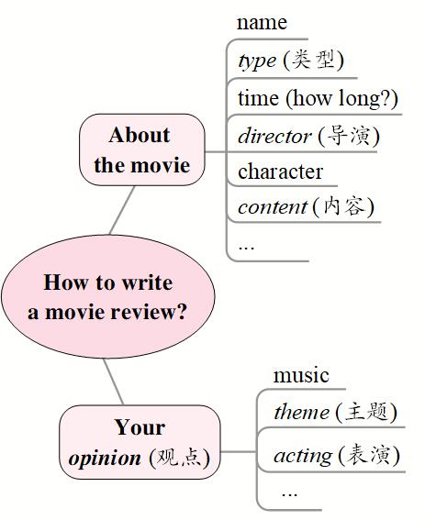
comedy, action movie, cartoon, scary movie, tragedy (悲剧), documentary (纪录片)
actor, actress, role, performer
story, happen / take place, scene (场面), climax (高潮), plot (故事情节)
good, great, educational, meaningless, serious, wonderful, enjoyable, relaxing, fun, exciting, boring, terrible

Slide 27

1. content:
The movie is about ... The movie shows ...
The film tells the story of ... It’s a love story ...
The story happened ... The movie tells me that ...

Slide 28
2. comment (评论):
I think the actress played ... role well.
The actors did a good job in the movie.
I enjoyed the movie very much.
It was very long.
The acting was true to life / excellent / weak (欠缺的) ...
It has a tragic (悲惨的) ending.
The dialogues are touching / boring ...
One of the most interesting parts is ...

Slide 29
3. recommendation (推荐):
Don’t miss it.
All in all, it’s worth (值得) seeing.
The film is a must-see.
It’s a film with a deep message.
I think it’s a good movie with ...

Slide 30

Red cliff is an exciting historical movie. The movie is about a famous battle that took place in southern China in 208 CE. The Prime Minister Cao Cao forces the Emperor Han to go to war with the kingdoms of Shu and East Wu. To protect themselves, the kingdoms of Shu and East Wu decide to form a partnership to fight against Cao Cao and his army. I enjoyed the movie very much. I think it is a great movie with a lot of good action scenes and strong characters. If you like history, you should watch Red Cliff!

Slide 31


What do you and your partner think of these TV shows or movies? Write description words for each one.
What do you think of soap operas?
I think they’re boring.
What about you?
…

Slide 32

A: Do you want to watch the news?
B: No, thanks.
A: Why not? Do you think it’s boring?
B: No, not at all. I really think the news is interesting.
A: Then why don’t you want to watch it?
B: I have to finish my homework.
A: Oh, OK.

Slide 33
 | Me | My partner
soap operas
talent shows
news
sports shows
game shows
talk shows
comedies
scary movies
action movies
cartoons

Slide 34
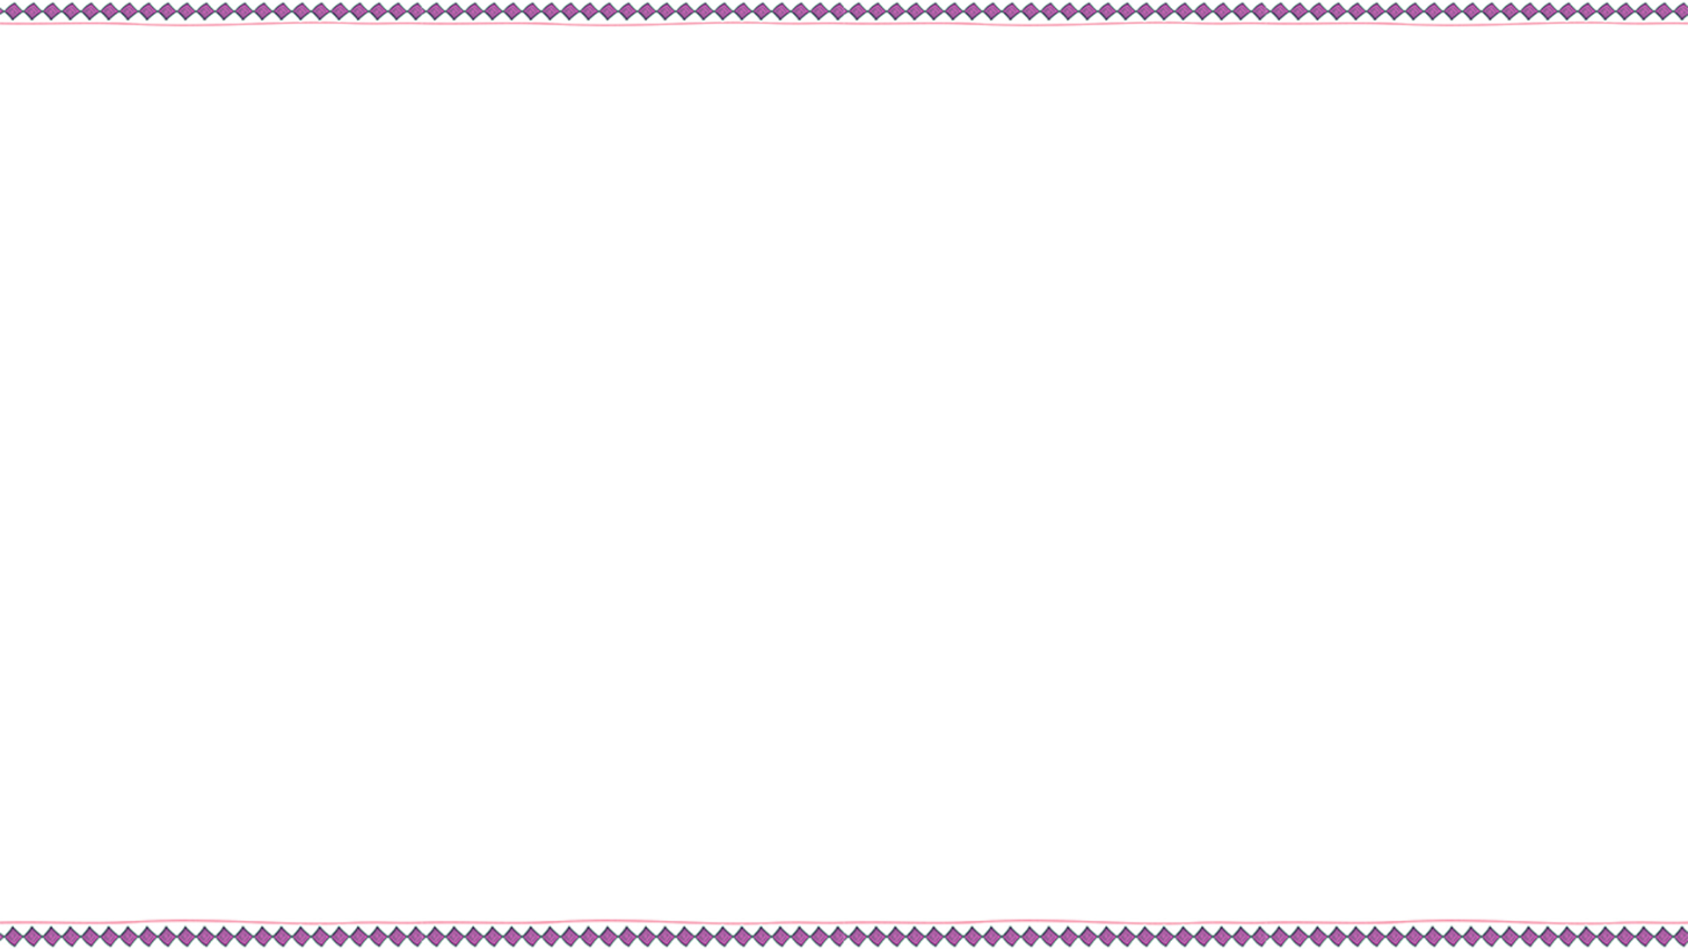

do a good job
_______________ 干得好
_______________ 装扮；乔装打扮
_______________ 代替；替换
fight in the army _________________
dress up
take sb.’s place
从军打仗

Slide 35
Entertainment
TV shows
Movies
Structures
sitcom, news, talk show, soap opera, game show, sports show, talent show
comedy, action movie, cartoon, scary movie
A: What do you think of talk shows?
B: I don’t mind them./ I can’t stand them./ I love watching them.
A: What can you expect to learn from sitcoms?
B: You can learn some great jokes.
A: Why do you like watching the news?
B: Because I hope to find out what’s going on around the world.
Description words
educational, meaningless, serious, exciting, boring, wonderful, relaxing, enjoyable, successful, famous, fantastic

Slide 36

Ⅰ.根据汉语意思，完成英语句子，每空一词。
My cat _______ ______ ______ _______(干得好) because there aren’t any mice in the kitchen.
Julie is a girl but she _______ ______ _____ _____ _____ (打扮得像一个男孩) to go to school.
For me, nobody can _______ _______ _________ _______ (代替我妈妈).
does a good job
dresses up like a boy
take my mother’s place

Slide 37
Ⅱ. 根据短文内容，从方框中选择恰当的单词填空。
happen, simple, success, hope, become, film, lucky, plan
Did you see the (1)________ The Wandering Earth? It comes from one of Liu Cixin’s works (作品). It is very (2)__________. It has won the hearts of people all over China. It tells us a story about saving the earth.
The earth is in great danger. Because the sun will (3)________ bigger and bigger.
film
successful
become

Slide 38
happen, simple, success, hope, become, film, lucky, plan
And it can eat up the earth. People all (4)________ the earth is OK. They have to make a(n) (5)________ to save it. They decide to move the earth to a new star system (星系). It isn’t (6)________. Things go very badly when the earth has to go past Jupiter (木星). It can fall into Jupiter. It’s very serious. To stop the (7)________ thing happening, people try their best to save the earth. Do you want to know what may (8)________ to the earth? Go to see the movie.
hope
plan
simple
unlucky
happen

Slide 39


Write your movie review using the notes in 3b.
List the new words and important expressions of this unit.

Slide 40


